Slide 1
Imputing Job Hunter Interest with Clustering, Logistic Regression and Ensemble Decision Trees
Elliott Chen, COMP-4449

Slide 2

Business Needs
We provide a two-sided marketplace to job hunters and those who are looking to hire
Our mobile application depends on an algorithm that decides on how to feed content to our users
Older iterations of the algorithm have tended to rely on inelegant brute force methods that are time-expensive, creating unwelcome long wait times for end users

Slide 3
Business Needs, cont.
We hope to leverage a neural net model that can make predictions on appropriate content to show our users more quickly and with better accuracy, but much of our potential training data does not yet have classifications
The goal of this project is to infer those classifications so that training the new machine learning model can proceed

Slide 4
Project Plan
Since we are inferring many classifications compared to the complete training data that we do have, establishing a benchmark for success will be complicated
Also since we are inferring many classifications and with relatively unstructured data, we will approach the problem from multiple angles
We will attempt to use clustering, logistic regression, and random forests to predict whether a job hunter (applicant) would be interested in applying for a given job

Slide 5
Project Plan, cont.
Performing logistic regression or random forest classification once the data is wrangled will be relatively straightforward—our label will be a binary variable
For clustering, we hope that applicant/job pairings will naturally form groups that are correlated with positive or negative interest in an opening; we will then be able to associate certain clusters with positive/negative interest creating a classification

Slide 6
Project Plan, cont.
Our main metrics considered will be precision and recall
The cost of false positives is feeding our end users content that is inappropriate for them; although we surmise that job hunters have a certain tolerance for irrelevant jobs and vice versa, seeing too many will sour user experience and depress growth
The cost of false negatives is junking content that our users would like to see; although they don’t know what they missed, we do not yet have so many profiles that we want to “waste” them in such a manner if we can help it

Slide 7
Data
We have ~1,400 rows of training data stored in a PostgreSQL database; each row represents an applicant expressing positive/negative interest in a job, or a job expressing positive/negative interest in an applicant, as well as the applicants’ and jobs’ profiles
In addition, we have roughly ten times that number of pairs of resumes and job posts that we hope to create binary classifications for

Slide 8
Data Wrangling
Perforce we have to train a model on the smaller dataset; but since we hope to extend it on the larger one, we will need to marry the two datasets somehow
We focus on extracting strings representing an applicant’s available and a job’s required technical skills and qualifications
Results are fed into sklearn’s TfidfVectorizer class to create features that track the frequency of skills mentioned in an applicant or job profile

Slide 9
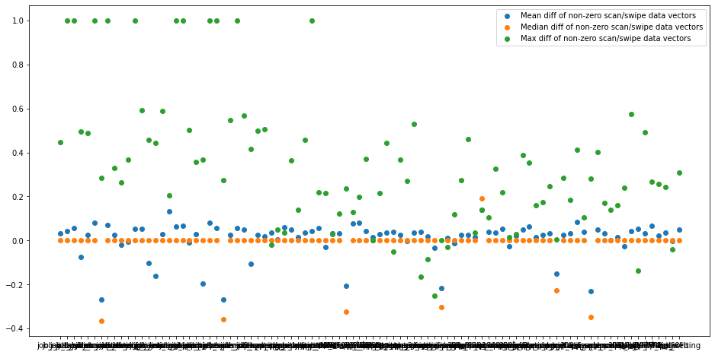
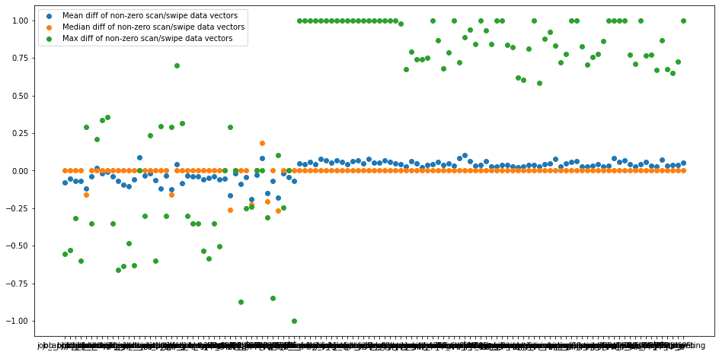
Data Wrangling, cont.
Two further issues need to be addressed: first, whether the features’ observations differ noticeably when the training and testing data are vectorized together
Difference between training/test data features vectorized together Difference between training/test data features vectorized independently

Slide 10
Data Wrangling, cont.
Secondly, whether it makes sense to combine two features measuring a job’s emphasis on a skill versus an applicant’s emphasis on a skill
For example: given a row that contains the column data job_Python=0.25 and applicant_Python=0.20, our models might not be able to intuit the connection between these two features
Might it make more sense to replace the two columns with a single column tracking the relationship between the two, most likely as a percentage?
In the example given, a single column observation Python=1.25 would replace the job and applicant columns

Slide 11
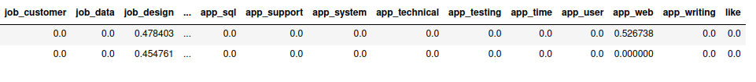
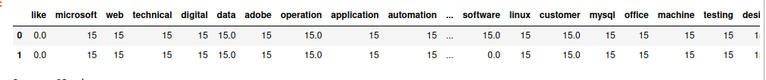
Data Wrangling, cont.
Given these two questions, four dataframes were generated to see which would yield the best results
Sample dataframe rows, one with separate job/applicant skill features and one with combined features:

Slide 12
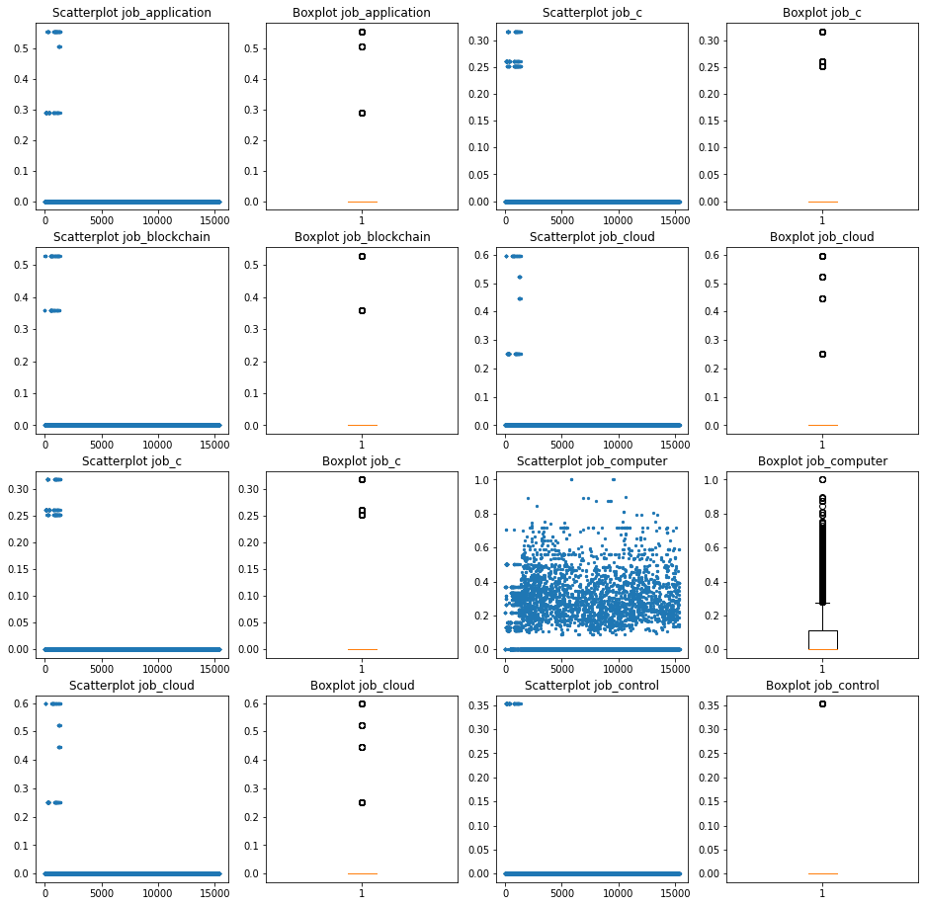
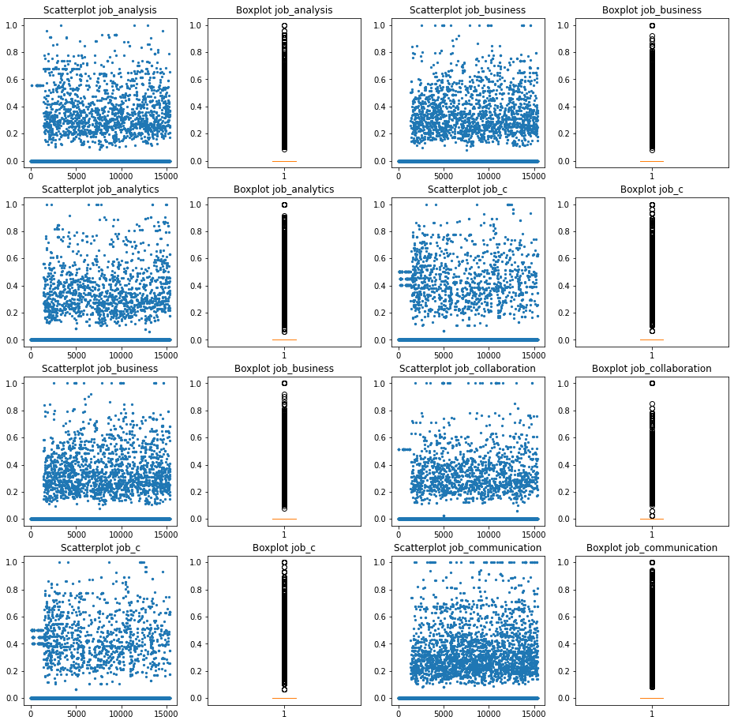
Data Visualizations
Independently Vectorized, Independent Job/Applicant Features Simultaneously Vectorized, Independent Job/Applicant Features

Slide 13
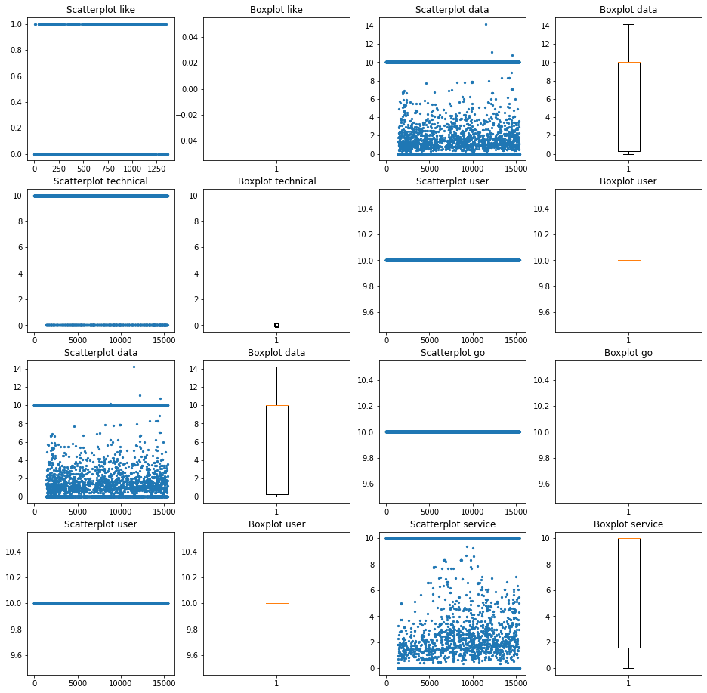
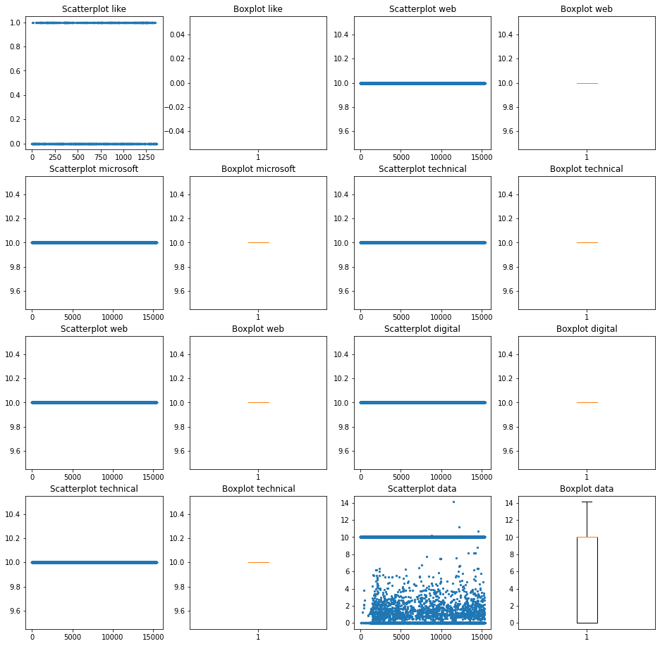
Data Visualizations, cont.
Independently Vectorized, Merged Job/Applicant Features Simultaneously Vectorized, Merged Job/Applicant Features

Slide 14
Clustering
Using the elbow method to determine an appropriate number of clusters for each dataframe after performing some dimensionality reduction through PCA, we arrive at a range from 7 to 14 clusters
We will attempt KNN and Gaussian distribution clustering, generating labels; we will then see if there is any correlation between our labels and the known outcome variables to see if clustering is a viable path forward

Slide 15
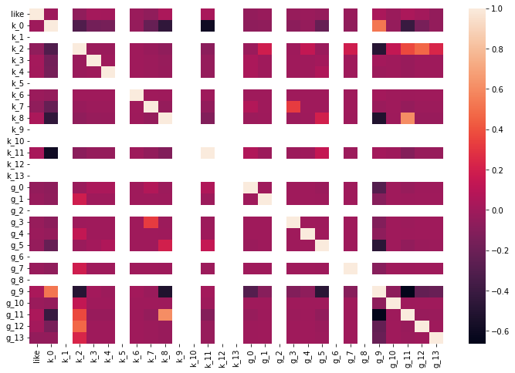
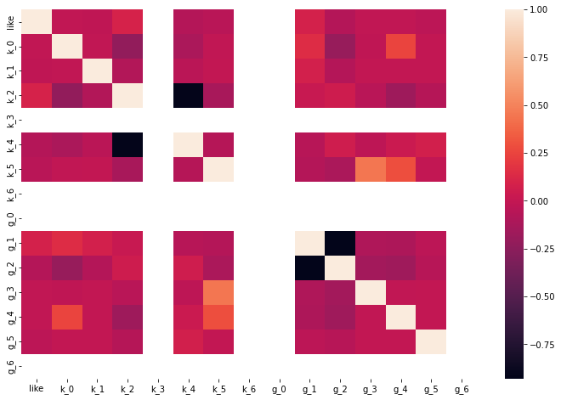
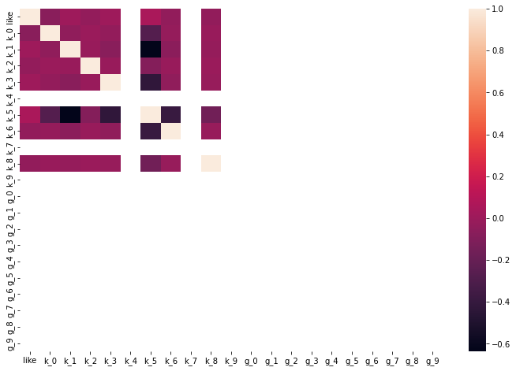
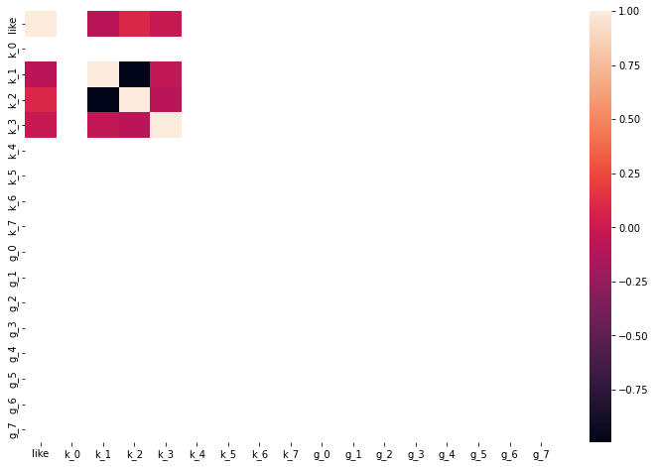
Clustering, cont.
In short: there were not enough notable correlations, and we will have to move on to logistic regression

Slide 16
Logistic Regression
After performing PCA, logistic regression models failed to deliver good results for any of our four dataframes; in some cases, they failed to converge altogether
Highest testing accuracy, precision and recalls achieved were 69%, 24%, and 65%
The recall is sufficient and overall accuracy is not atrocious, but this precision is unacceptably low

Slide 17
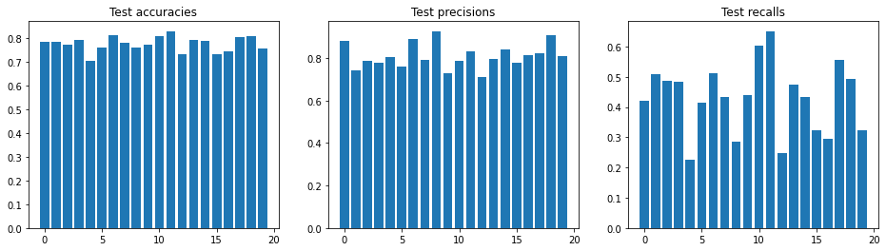
Ensemble Decision Trees
Our random forests gave good results; out of twenty models trained, five for each dataframe, the one with best accuracy (83%) and recall (65%) still delivered a very acceptable precision (83%)
This model was trained on the dataframe where the expressions of interest and resume/job pairings were vectorized simultaneously, and where the applicant/job skill features were merged together

Slide 18
Conclusion and Next Steps
Our selected model is a random forest classifier with a max depth of 12, max features of 0.25, and 75 estimators
When creating classifications for the resume/job data, this model predicted that roughly one in ten people who compared their resume to a job would express positive interest in that job
Time to start tinkering with a neural net!

